Slide 1



Challenge Name: Break The Limit (Well Probability) Team Name: Cluster Champs
Data Science Hackathon

Slide 2
Agenda Style
A
Problem Statement
B
Data Findings
C
Implications
D
Deep Dive on Solution / Prototype
E
Summary and Call for Action

Slide 3
Introduction
Notes:
Offshore deepwater well – approx. $20 million
Offshore shallow water well – approx. $ 5million
TEN Field (Oil) Production as at May 2020 – 1,549,299.00 (bbl)
Jubilee Field (Oil) Production as at May 2020 – 2,814,085.00 (bbl)
(OCTP) Sankofa/Gye Nyame Field (Oil) Production as at May 2020 – 1,564,642.07 (bbl)

Slide 4



Our Team Layout
Abanisenioluwa Kolawole Orojo
Team Lead
Efa Aku Akoto
Programmer
Slyvia Tawiah Tetteh
Programmer

Slide 5
Problem Statement
01
02
What is the probability of the well generating oil
What is the probability of the well generating gas

Slide 6
Timeline Of Model
Problem Definition
Data Gathering
Data Preparation
Choose a Model
Train the Model
Brainstorming session which was filtered to two main problems
Rock Eval Pyrolysis was used to gather the parameters needed to train the model
All missing value were removed from the data. Then new feature were added then the data was MaxAbsScaler before being pasted to the model
Multiple classification models were chosen. These were filtered to the final model which was an AdaBoost Classifier
Model was trained using the best parameters and cross validation scores were also recorded

Slide 7
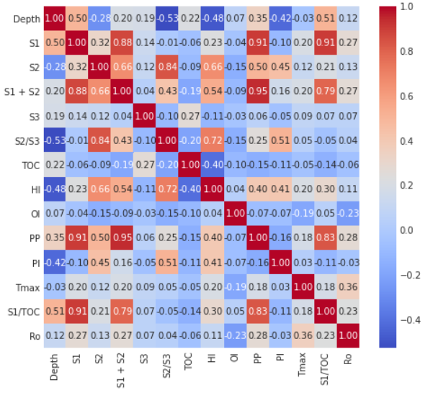
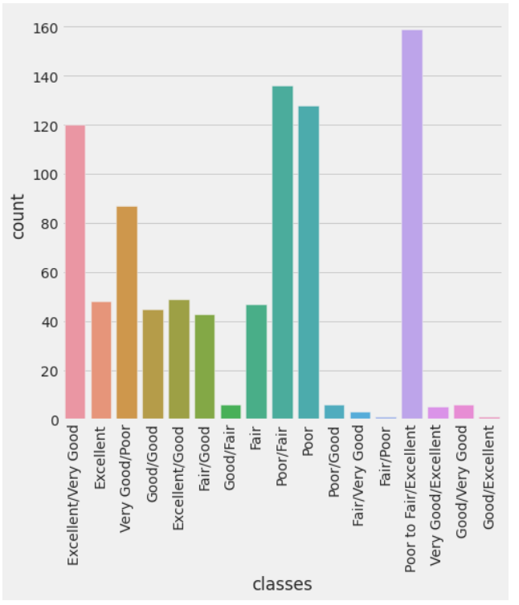
Data Finding
Counting Plot
Correlation Plot

Slide 8
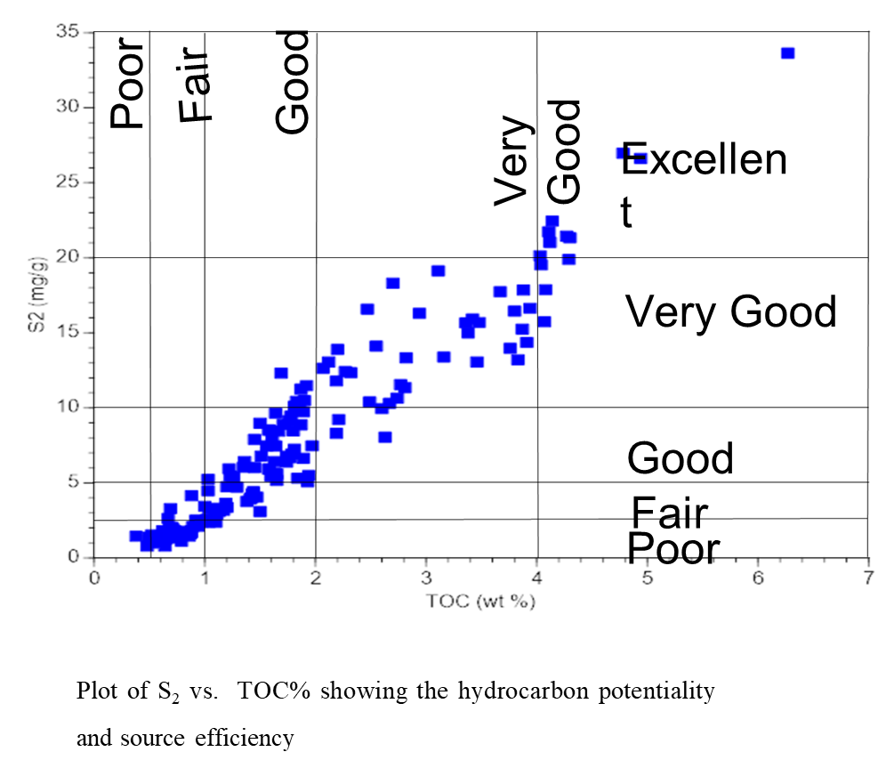
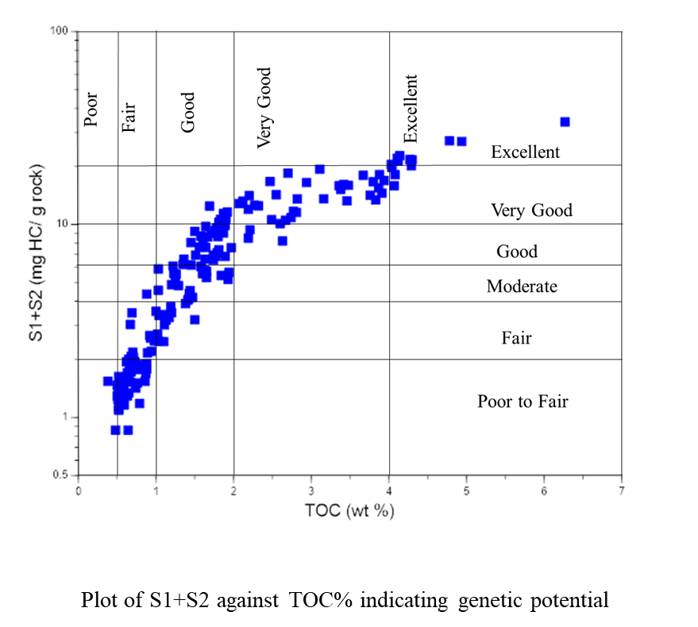
Implications

Slide 9
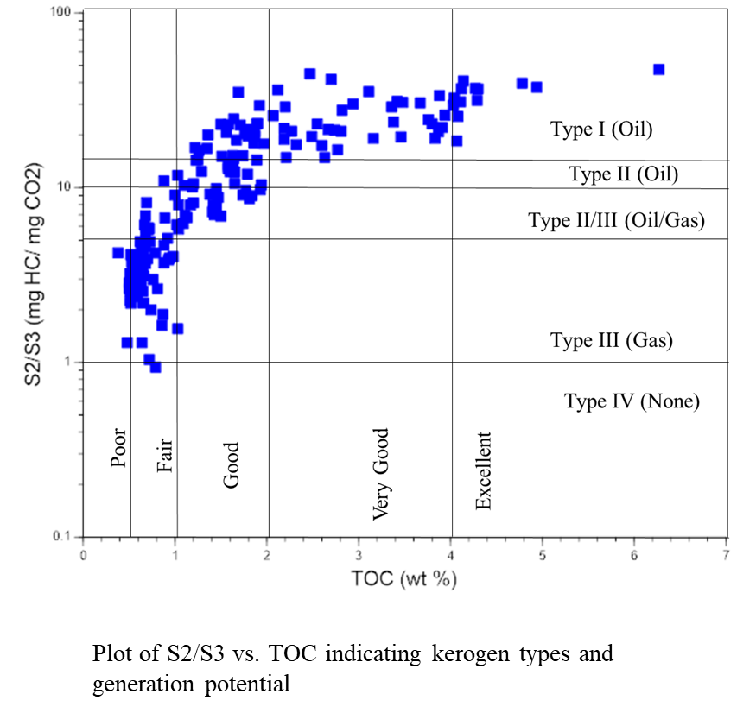
Implications

Slide 10
Deep Dive on Solution / Prototype

Slide 11
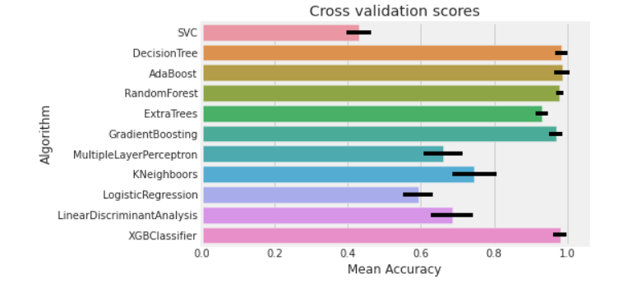

Model Comparism by Accuracy

Slide 12
Hyperparameter Tuning
XGBoost
Decision Tree
Adaboost
Notes:
DTC = DecisionTreeClassifier()
dtc_param_grid = {"max_depth": [None],
"max_features": [1, 3, 10],
"min_samples_split": [2, 3, 10],
"min_samples_leaf": [1, 3, 10],
"criterion": ["gini"]}
XGB = XGBClassifier()
xgb_param_grid = {"n_estimators" :[100,300],
'learning_rate': [0.0001, 0.001, 0.01, 0.1, 0.2, 0.3,1.5],
"criterion": ["gini"],
'max_depth': [4, 8],
'min_samples_leaf': [100,150],
'max_features': [0.3, 0.1] }
adaDTC = AdaBoostClassifier(DTC, random_state=7)
ada_param_grid = {"base_estimator__criterion" : ["gini", "entropy"],
"base_estimator__splitter" : ["best", "random"],
"algorithm" : ["SAMME","SAMME.R"],
"n_estimators" :[1,2],
"learning_rate": [0.0001, 0.001, 0.01, 0.1, 0.2, 0.3,1.5]}

Slide 13
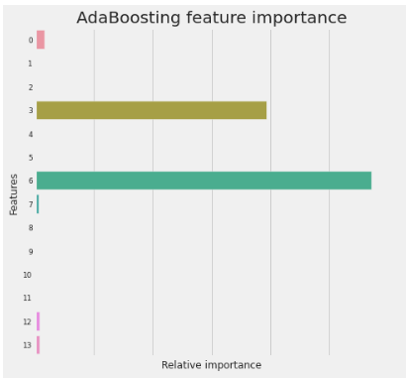
Most Important Feature
Notes:
TOC
S2

Slide 14
Summary and Call for Action
Cost
Time
Cost-Effective
Saves time in well exploration
Highest Probability
Best Classifier
Further Research
If S2 >= 20 mg HC/ g rock and TOC >= 4, you will have the highest probability of your well producing oil
The best classifier was the AdaBoost as it performed best on all metrics
This is the first step in machine learning for classifying different wells

Slide 15
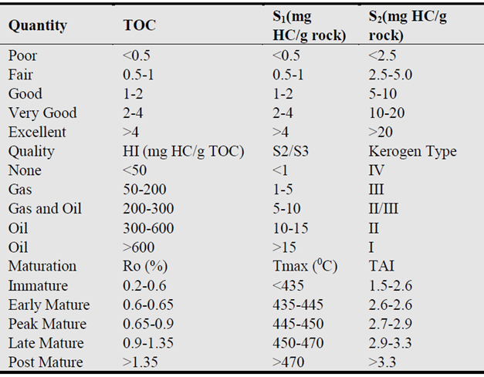
Appendix
.
Guidelines for interpreting source rock quantity, quality and maturation, and commonly used Rock-Eval parameters.

Slide 16
Thank you

